Slide 1




Module Name - Searching & Sorting algorithms
Topic Name: Merge Sort
EditEdit MasterMaster texttext stylesstyles

Slide 2

Today’s Agenda
Introduction to Merge Sort
Java Implementation of Merge Sort
Time Complexity of Merge Sort
Introduction to Quick Sort
Java Implementation of Quick Sort

Slide 3
Today’s Agenda
Worst Case Time Complexity of Quick Sort
Best Case Time Complexity of Quick Sort
Worst Case Time Complexity of Quick Sort
Best Case Time Complexity of Quick Sort

Slide 4
Today’s Agenda
Quick Sort vs Merge Sort
Comparison of Sorting Algorithms

Slide 5
Merge Sort
So, we have learnt 3 algorithms so far but all of them have the time complexity of O(n²). But can we further reduce this time complexity by using some other algorithms?
What if we try to divide our problems into subproblems and then try???
Yes, once again, it’s Divide and Conquer to the rescue!!!
We’ll be looking at Merge Sort algorithms today.

Slide 6
Merge Sort
Let’s start by dividing our main array into two subarrays:
8 | 6 | 3 | 1 | 4 | 2 | 7 | 5
8 | 6 | 3 | 1
4 | 2 | 7 | 5
If we somehow manage to sort these subarrays individually, can you think of how to combine(or MERGE) them?
1 | 3 | 6 | 8
2 | 4 | 5 | 7

Slide 7

Merge Sort
Let’s start with two pointers at the starting of each subarray and start filling our original sized array with the sorted elements from these subarrays one at a time.
Just simply increment the pointer of the subarray whose pointer element is smaller that the pointer element of the other subarray after writing it to the main array.
The arrays and subarray will look like this somewhen during the process using this principle:
1 | 3 | 6 | 8
2 | 4 | 5 | 7
1 | 2 | 3 | 4 | 5

Slide 8
Merge Sort
Now that you know the process of merging two sorted subarrays, it’s time to find out how to sort these two subarrays.
We divided our main array into two subarrays, we can also divide our subarrays into two subarrays each and merge those sub-subarrays to obtain our sorted subarrays.
We can keep splitting each subarray in the same way into smaller and smaller subarrays. What do you think will be the terminating condition for this recursion?

Slide 9
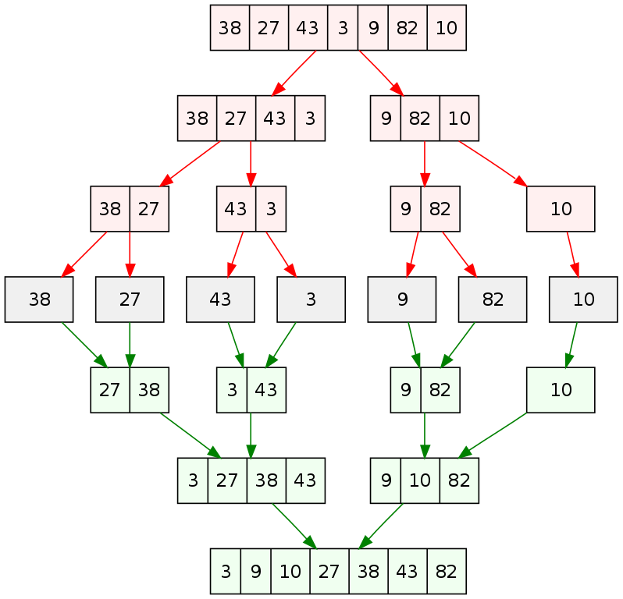
Merge Sort
We will continue this division of subarrays until there is only one element in the subarray, which will make it sorted by default.
And then we can start merging from that point and finally obtain our sorted array!
This example towards the right will clarify the entire process to you furthermore.

Slide 10
Java Implementation of Merge Sort
Well, that was the logic behind the Merge Sort algorithm. Let’s start with the code now.
You know that by now, that the algorithms has two main functions; to split the array into subarrays and sub-subarrays, and to merge the sorted subarrays till we get the full sized sorted array. Let’s take a look at the first recursive function for dividing the subarrays:
public static int[] mergeSort(int[] numbers, int first, int last){
if (first < last) {
int mid = (first + last) / 2;
mergeSort(numbers, first, mid);
mergeSort(numbers, mid + 1, last);
merge(numbers, first, mid, last); }
return numbers;
}

Slide 11
Java Implementation of Merge Sort
Now, let’s look at the main function, merge which was called in our recursive function, mergeSort after every division of a subarray. The objective of this function, as the name suggests, is to merge the two sorted subarrays into a bigger sorted array/subarray.
private static void merge(int[] numbers, int i, int m, int j) {
int l = i; // initial index of first subarray
int r = m + 1; // initial index of second subarray
int k = 0; // initial index of merged array
int[] t = new int[numbers.length];
while (l <= m && r <= j) {
if (numbers[l] <= numbers[r]) {
t[k] = numbers[l];
k++;
l++;
} else {
t[k] = numbers[r];
k++;
r++; }}}
Do you think the function is complete?
Or is there anything that should be added?

Slide 12
Java Implementation of Merge Sort
The given code segment did not cover the case when one subarray is completed and other one still has some/all elements remaining. To cover it, check the following code:
// Copy the remaining elements on left half , if there are any
while (l <= m) {
t[k] = numbers[l];
k++;
l++;
}
// Copy the remaining elements on right half , if there are any
while (r <= j) {
t[k] = numbers[r];
k++;
r++;
}
The only part now left, is to update the original array with the sorted elements...

Slide 13
Java Implementation of Merge Sort
The given code segment updates all the elements of our sorted array into the original array:
l = i;
k = 0;
while (l <= j) {
numbers[l] = t[k];
l++;
k++;
}
This completes our code of merge sort. Do you have any queries regarding it?

Slide 14
Time Complexity of Merge Sort
So, we have seen the complete code of Merge Sort. Let’s analyze its time complexity now:
Step 1: Divide
For dividing, we will compute the middle of the given ‘n’ number of elements. This would take a constant time, let’s say D(n)= Θ(1)
Step 2: Conquer
The sequence of ‘n’ elements is divided into n/2 elements each and those, further into n/2 each. Therefore, we are recursively solving two sequences of n/2 elements that give us time complexity, let’s say 2T(n/2)
Step 3: Merge
Combining the subarrays of ‘n’ elements would take time C(n)= Θ(n).

Slide 15
Time Complexity of Merge Sort
We can therefore conclude that:
T(n) = 0, if n<=1
T(n) = T(n/2) + T(n/2) + D(n)+ C(n), otherwise
OR
T(n)= 2*T(n/2) + Θ(n) + Θ(1)
For ease of calculations, let’s ignore Θ(1) and replace Θ(n) with n.
i.e T(n)= 2*T(n/2) + n and using Substitution,
T(n/2) = 2*(2*T(n/4) + n/2) =2² T(n/2²)+n

Slide 16
Time Complexity of Merge Sort
Using the substitution, we can rewrite the T(n) equation as:
T(n) = 2²*T(n/2) + 2n and using subsequent substitutions,
.
.
.
= 2k(2*T(n/2) + kn
Now, assuming n=2^{k} and therefore k=log₂n :
T(2^{k}) =nT(n/n)+logn*n
= n*T(1) + nlogn
And since T(1) = O(1), T(n) = O(nlogn)

Slide 17
Quick Sort
Finally, we got to see our first nlogn sorting algorithm. Now let’s QUICKLY check the next algorithm as well. And yes, this one follows the divide and conquer technique too.
Let’s once again start by dividing our main array into two subarrays. BUT, instead of splitting through centre, let’s choose a pivot element, say LAST element i.e. 4 and sort the array into elements smaller and larger than 4.
But our approach will be to rearrange the original array instead of creating a new array of the same size. This will be done with the help of a partition pointer other than start and end pointers. Let’s take a closer look step by step:
7 | 2 | 1 | 6 | 5 | 3 | 8 | 4
Pivot

Slide 18

Quick Sort
We’ll start with the partition pointer at the first element i.e. 7 and iterate throughout the array. If an element is lesser than pivot element i.e. 4 here, then:
The element is swapped with the element at the partition pointer
The partition pointer is incremented after swap
So, when the loop runs, the first step is comparing the 1st element(7) with pivot(4). Since 7 is not smaller than 4, nothing happens and we move to next element i.e. 2.
Now, since 2 is smaller than 4, 2 and 7 are swapped and partition pointer is incremented and again points to 7.
7 | 2 | 1 | 6 | 5 | 3 | 8 | 4
Pivot
Partition

Slide 19

Quick Sort
Now, let’s do the same procedure for the remaining array. The resultant array will be:
Now, we should place our pivot(4) at its correct position in sorted array. Can you tell the approach to complete our objective?
SWAP 1
(2,7)
SWAP 2
(1,7)
SWAP 3
(3,7)
2 | 1 | 3 | 6 | 5 | 7 | 8 | 4
Pivot
Partition

Slide 20
Quick Sort
Yes, you guessed it right! We simply need to make a final swap of our pivot element with the element pointed by the partition pointer. The final thus becomes:
Now, we can use the same algorithm to sort the sub arrays to the left and right of our pivot element i.e. 4. And using this partition function recursively, we can sort the whole array. Let’s take a look at the final code.
2 | 1 | 3
4
5 | 7 | 8 | 6

Slide 21
Java Implementation of Quick Sort
Like merge sort, this algorithm also has two main functions:
The recursive calling function,quickSort, to divide the arrays into subarrays to be sorted
The partition function, which puts the pivot element into its correct position and partitions the array into elements smaller(and equal), and larger than the pivot element.
Let’s see both these functions one by one:
public static void quickSort(int[] ar, int start, int end) {
if (start < end) {
int p = partition(ar, start, end);
quickSort(ar, 0, p - 1);
quickSort(ar, p + 1, end); }}

Slide 22
Java Implementation of Quick Sort
public static int partition(int[] ar, int start, int end) {
int pivot = ar[end];
int i = start;
for (int j = start; j < end; j++) {
if (ar[j] <= pivot) {
int temp1 = ar[j];
ar[j] = ar[i];
ar[i] = temp1;
I++; }}
int temp2 = ar[i];
ar[i] = ar[end];
ar[end] = temp2;
return i; }

Slide 23
Time Complexity of Quick Sort
Now that we have seen the code, you know the next step. Yes, it’s analyzing the time complexity. But this time we will find out the time complexity for both the worst and best case scenarios.
What do you think will be the worst case scenario for quicksort?
What do you think will be the best case?

Slide 24
Time Complexity of Quick Sort
The worst case will be when the array is sorted already. Quite ironic, isn’t it? But why do you think it is so?
Let’s take a look at the quick sort function once again to understand it better:
public static void quickSort(int[] ar, int start, int end) {
if (start < end) {
int p = partition(ar, start, end);
quickSort(ar, 0, p - 1);
quickSort(ar, p + 1, end); }}
Majority of the partition function comprises of declaration and assignment statements which follow O(1). The main loop in the function will always run from start to end pointer each time, which means it has the time complexity of O(n).

Slide 25
Time Complexity of Quick Sort
Now, if the array is already sorted, partition function will always return p as end. Therefore, only the the first quickSort function is executed every time(total n times); the second quickSort is never executed.
Since, only the first quickSort sub-function is executed every time, the time complexity equation of quickSort becomes:
T(n) = n+T(n-1)+0 (Corresponding to the 3
statements in quickSort)
and using Substitution, T(n) = [T(n-2)+(n-1)] + n
=T(n-2)+ 2n-1
Similarly, for kth substitution: T(n) =T(n-k)+ kn + ∑(k-1)
=T(n-k)+ kn + k(k-1)/2

Slide 26
Time Complexity of Quick Sort
T(n) =T(n-k)+ kn + k(k-1)/2
Now, assuming n-k=1 and therefore k=n-1:
T(n) =T(1)+ n(n-1)+ (n-1)(n-2)/2
= an² + bn + c (a,b,c are some constant values)
∴T(n) = O(n²)

Slide 27
Time Complexity of Quick Sort
Now let’s find out the best case time complexity. The best case scenario is when the pivot is correctly placed in the exact middle of each array/subarray. Thus, the sorting will be equally divided between both the quickSort functions(which obviously is complete opposite of worst case scenario).
Hence, the time complexity equation of the function comes out to be:
T(n) = n+T(n/2) +T(n/2) (Corresponding to the 3
statements in quickSort)
T(n) = 2*T(n/2)+ n
Does this equation ring any bells? Have you ever solved this equation before?
YES!!! This is the exact same equation for the analysis for the time complexity of MERGE SORT. So, can you solve this equation on your own now?

Slide 28
Time Complexity of Quick Sort
Using the substitution, we can rewrite the T(n) equation as:
T(n) = 2²*T(n/2) + 2n and using subsequent substitutions,
.
.
.
= 2k(2*T(n/2) + kn
Now, assuming n=2^{k} and therefore k=log₂n :
T(2^{k}) =nT(n/n)+logn*n
= n*T(1) + nlogn
And since T(1) = O(1), T(n) = O(nlogn)

Slide 29
Time Complexity of Quick Sort
Now that we have seen the code, you know the next step. Yes, it’s analyzing the time complexity. But this time we will find out the time complexity for both the worst and best case scenarios.
What do you think will be the worst case scenario for quicksort?
What do you think will be the best case?

Slide 30
Time Complexity of Quick Sort
The worst case will be when the array is sorted already. Quite ironic, isn’t it? But why do you think it is so?
Let’s take a look at the quick sort function once again to understand it better:
public static void quickSort(int[] ar, int start, int end) {
if (start < end) {
int p = partition(ar, start, end);
quickSort(ar, 0, p - 1);
quickSort(ar, p + 1, end); }}
Majority of the partition function comprises of declaration and assignment statements which follow O(1). The main loop in the function will always run from start to end pointer each time, which means it has the time complexity of O(n).

Slide 31
Quick Sort Vs Merge Sort
You’ve learnt both Merge Sort and Quick Sort today. But which one is better? Before we get to the answer of this question, let’s learn about two new terms first:
Stability: If a sorting algorithm outputs two elements with same key but different values in the same order as the one prior to sorting, it is said to be sorted.
For eg. Given X-Y coordinate pairs (11,8), (5,5), (2,18), (9,0), (5,1) and sorting on the basis of increasing X coordinates, if (5,1) comes after (5,5), it is said be stable.
In-Place: If a sorting algorithm does not require extra space of similar size to the input array, i.e does not have space complexity of O(n) or higher, it is said to be in-place.
Now can you tell which of the algorithm is/are stable and in-place?

Slide 32
Quick Sort Vs Merge Sort
Let’s see the comparison with the help of a table:
Now you know that if you need to preserve the order of the input elements after sorting, or if you have constraint on memory usage which sorting algorithms to prefer. Which one will you prefer in the former case?
Quick Sort | Merge Sort
Not stable | Stable
In-Place | Not in-place

Slide 33
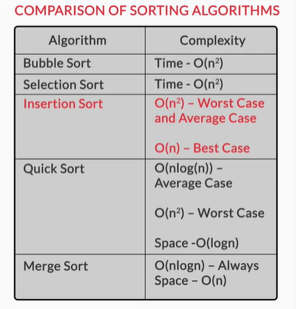
Comparison of Sorting Algorithms
Congratulations!!! You’ve learnt 5 sorting algorithms. The following table summarizes the analysis of all the algorithms:

Slide 34

Thank You!
Happy learning!
#LifeKoKaroLift

